Slide 1
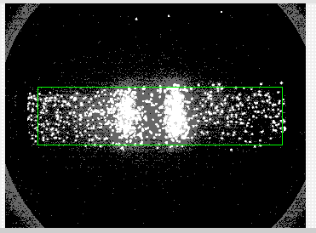
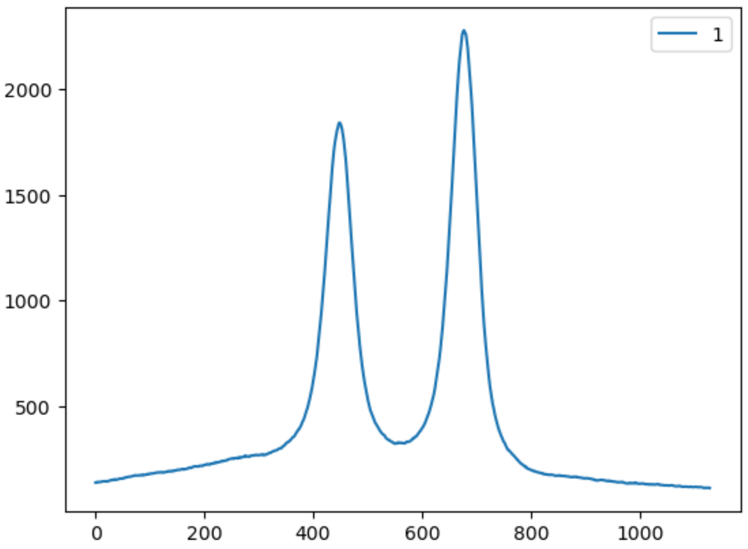
2D image data (one frame per time step [~12Hz])
1/dt (“dt” in Metadata.json)
“Rectangle” in Metadata.json
2D image vertically binned spectrum
Frame Stream.bin
ESpectrum Stream.bin
Pixel
Pixel (Energy axis)
Pixel (Energy axis)
Count per second: ~ E6
(Meta)Data in “TRS”
trs_refactor.py in “python”

Slide 2
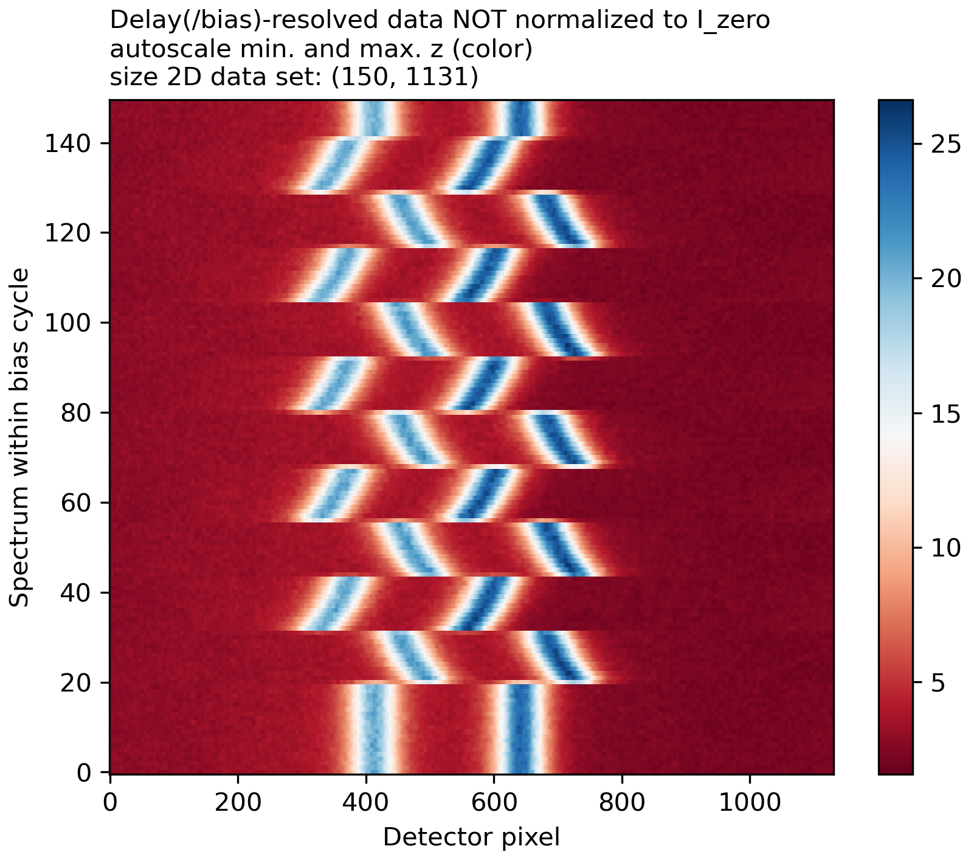
2D energy- and time-resolved map (file #3)
(Metadata)
F_Reset
F_Dead
Time
F_Trigger
Pixel (Energy axis)

Slide 3
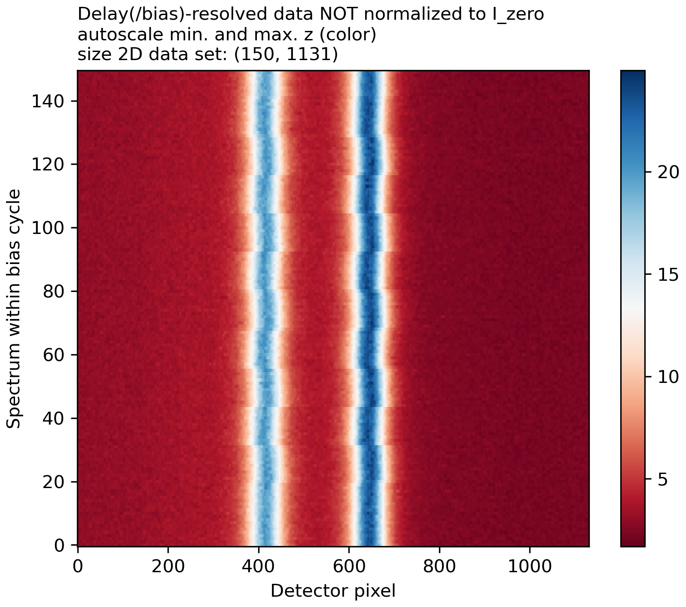
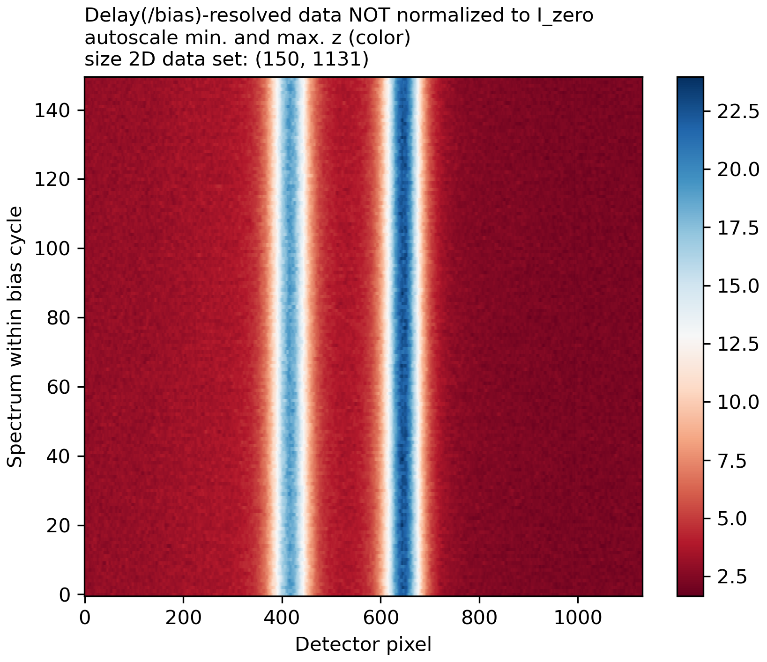
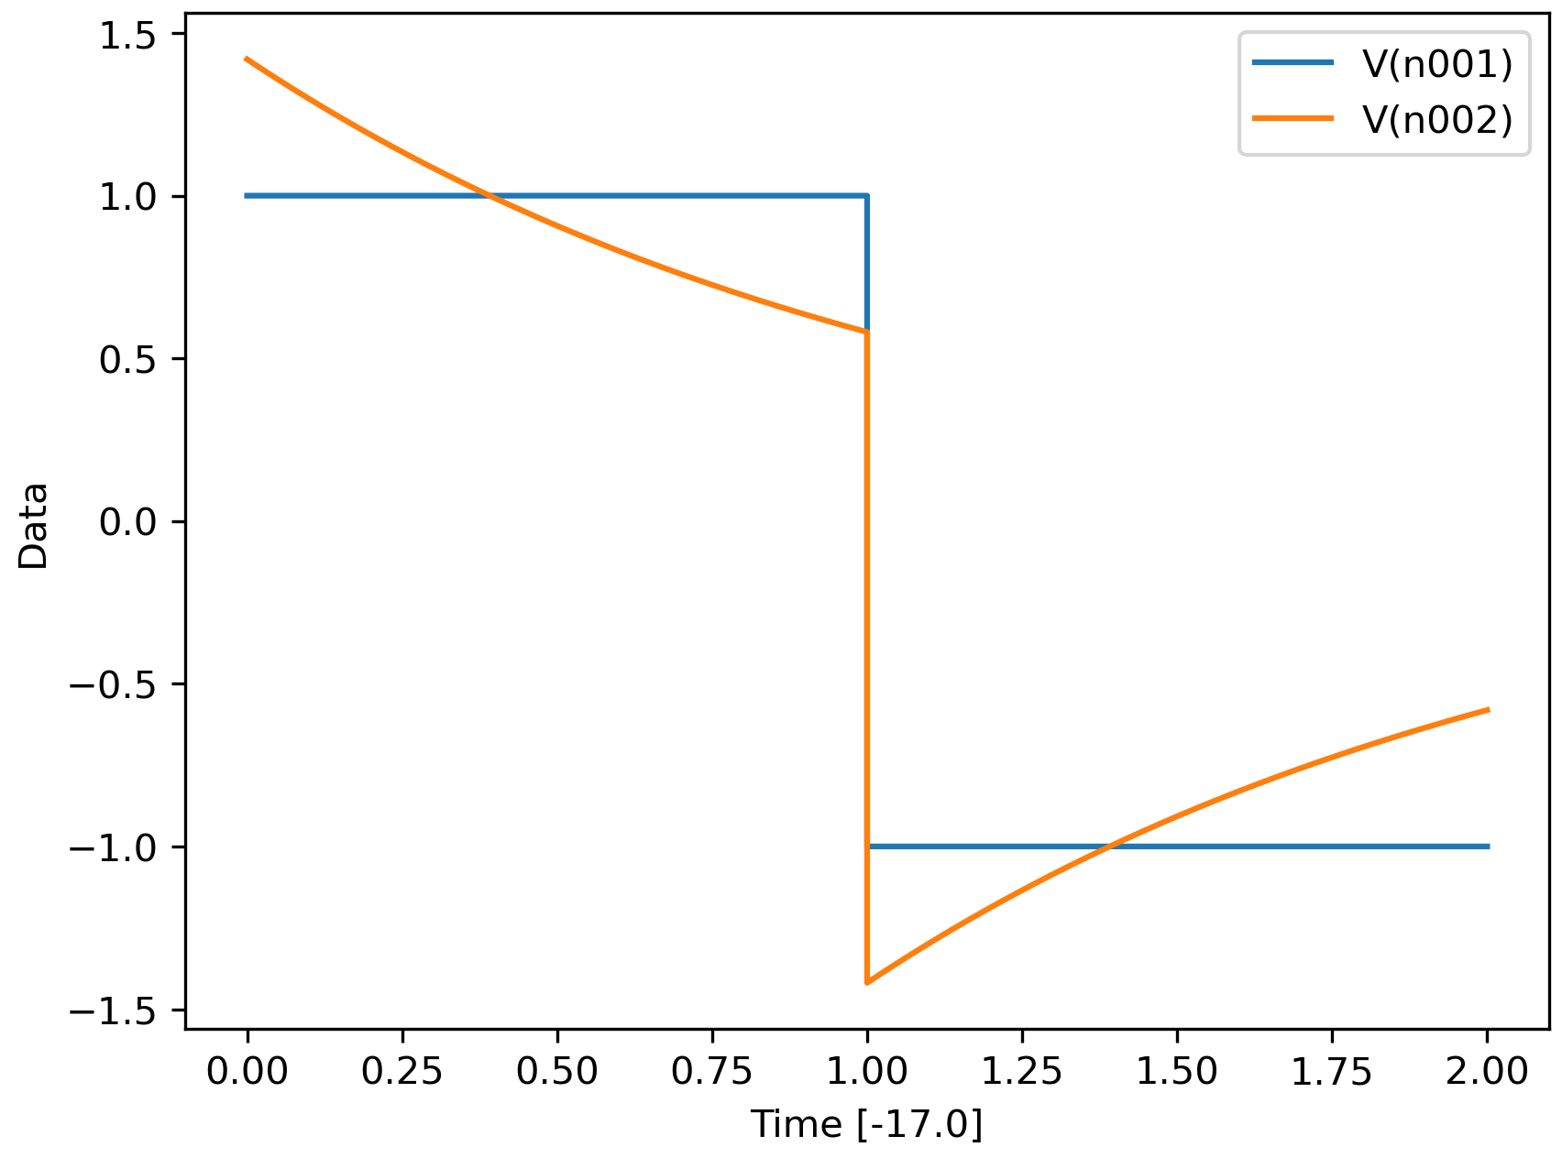
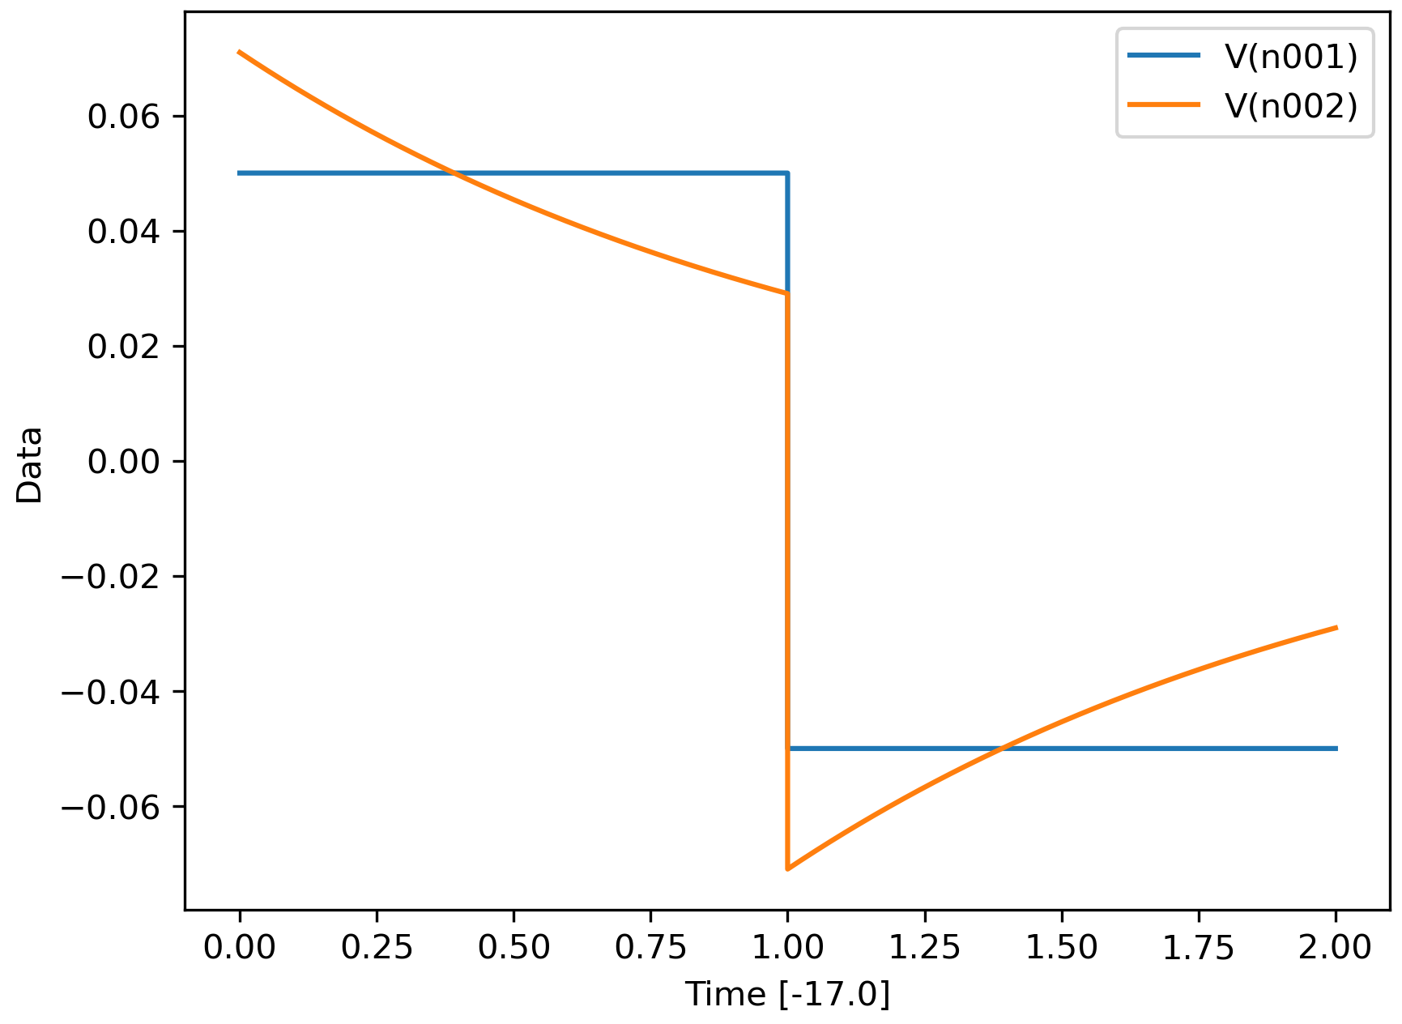
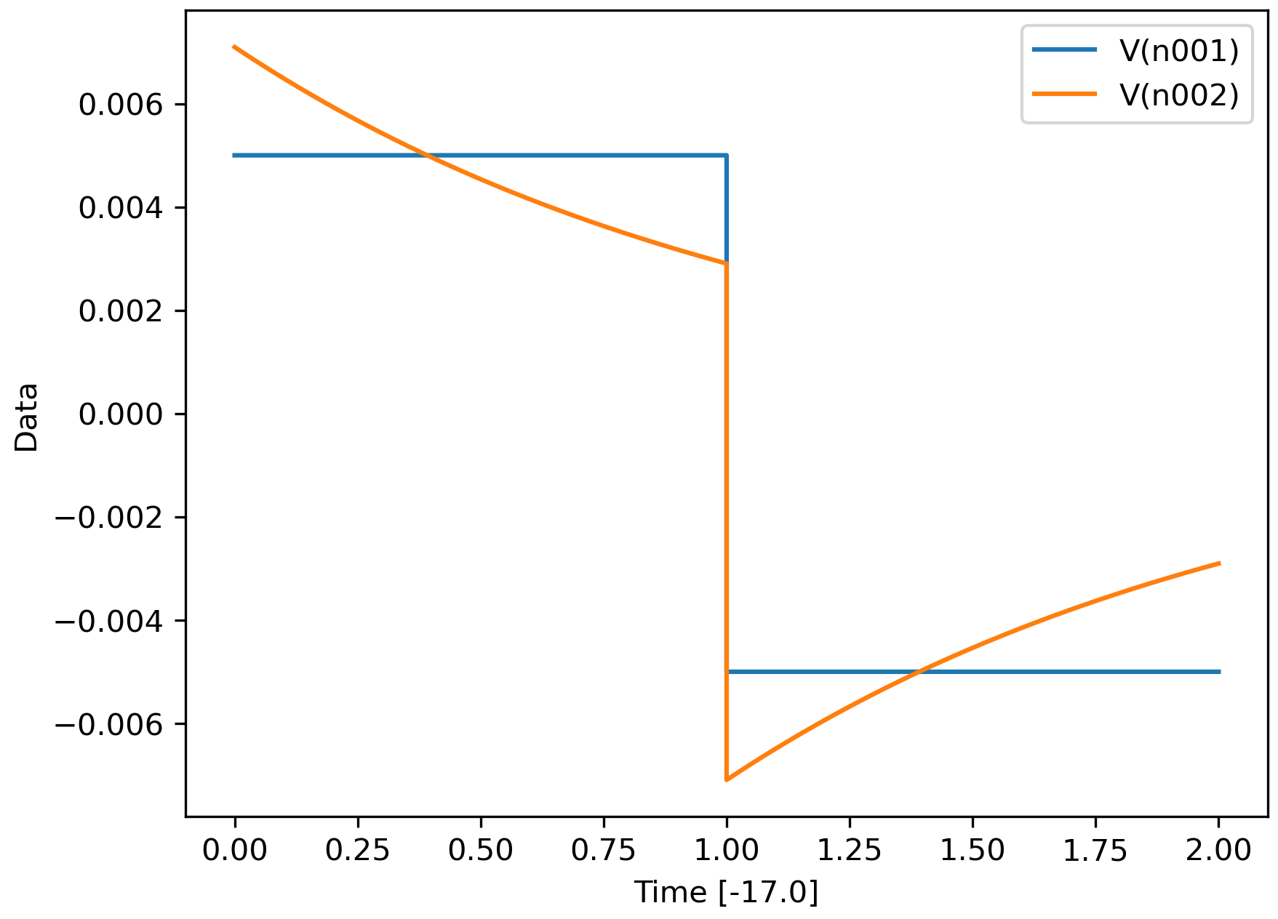
f_bias=0.5Hz, tau=1s, deltaV: 1000, 50, 5mV
file # 3, 7, 10

